Slide 1
9/19/18 Weekly Meeting Update
Initial System Block Diagrams and Research Update

Slide 2
Agenda
Initial system diagram
Initial chip diagram
Research updates

Slide 3
Initial System Diagram v1- Flood Team Prototype
Power
Processor
Comms
Aggregator
Wire-In

Slide 4
Initial System Diagram v2- Showcase Demo
Power
Processor
Comms
Aggregator
Built in Sensor

Slide 5
Initial System Diagram- Notes
Our device can’t be put underwater, because sunlight would be diminished and transmitting to aggregator would be impossible
Our prototype 1 receives data from underwater flood sensor through physical wire for the same reasons (receiving underwater signal too difficult for low power solution)
Would like our demo to sport it’s own sensor

Slide 6
Initial Chip Diagram
Depends on the size of the battery and our processing needs
Processor put with comms or sensor, depending on size requirements
Solar Cell/EH IC
Battery
Processor/ Comms
Wire-In (or Sensor)

Slide 7
Research Update
Power
Storage options available, TI (and others) have EH ICs
Processors
ARM processors are probably our best bet since they would give us flexibility
Comms
LoRa may not be feasible
Sensor
A few different options depending on the sensor method we choose

Slide 8
Power Storage
https://en.wikipedia.org/wiki/Energy_density
https://www.machinedesign.com/batteriespower-supplies/what-s-difference-between-batteries-and-capacitors
https://www.androidauthority.com/lithium-ion-vs-solid-state-battery-726142/
https://www.ilika.com/images/uploads/general/Ilika_Stereax_FAQ-V1.01.pdf
https://www.ilika.com/battery-technology/products
Summary: Want a battery, not a supercapacitor. SSBs are “better”, but expensive and not large enough at the moment
DigiKey: chargeable Panasonic/Illinois Capacitor coin cells for first prototype
https://www.digikey.com/products/en/battery-products/batteries-rechargeable-secondary/91?k=batteries&k=&pkeyword=batteries&pv46=42903&sf=0&FV=ffe0005b%2C670004a&quantity=&ColumnSort=0&page=1&pageSize=25
https://www.digikey.com/product-detail/en/illinois-capacitor/RJD3032ST1/1572-1633-ND/6596421
https://www.digikey.com/product-detail/en/illinois-capacitor/RJD2032C1ST1/1572-1628-ND/6596416
https://www.digikey.com/product-detail/en/illinois-capacitor/RJD2430C1ST1/1572-1630-ND/6596418
Thought: Solar cell -> EH IC -> SSB. Use SSB to charge larger capacitor for power hungry transmissions that need more current?

Slide 9
Processors
 | MSP430 (Ultra-low power line) | ARM M0+ (Atmel SAM L21 Family) | ARM M0+ (SAM D21 Family) | ARM M4F (ADuCM4050)
Power (µA/MHz) | 100-200 | 32 (at 12 MHz) | 117 (at 12 MHz) | 41-55
SRAM | 0.5-8 KB | 4-40 KB | 4-32 KB | 128 KB
FRAM | 4-256 KB | - | - | -
Flash | - | 32-256 KB | 32-256 KB | 512 KB
GPIO | 12-83 | Up to 51 | 32-64 | 44-51
CPU | 32 kHz - 24 MHz | Up to 48 MHz | Up to 48 MHz | Up to 52 MHz
Notes:
Atmel SAM L21 Family
Analog Devices M4F

Slide 10
Sensors
 | Ultrasonic | Honeywell board mount | Max Sonar | Lidar (VL53L0X Time-of-Flight ranging sensor)
Interface |  | SPI, I2C, analog opts | RS232 format | I2C
Size |  | 10mmx10mm | ~16x16x16 mm | 4.4 x 2.4 x 1.0mm
Pressure Range | ----- | 1.6 mbar to ±10 bar | ------- | ----
Depth/ dist | 1.3- 2m | > 20in H20 | 20cm - 7.5m | < 2m
Output type |  | Digital 14-bit, or analog | Analog, pulse width, or serial | digital
Power |  | <10 mW, typ |  | Average power consumption 20mW at 10Hz w/ 33ms ranging sequence
Current draw |  |  | 2.7mA (50mA peak) @ 3.3V | Standby: 5uA, peak: 40mA
Voltage | 9-30V | 3.3 or 5V | 3-5VDC | 2.6-3.5V
Notes |  | board-mounted

Slide 11
Comms
LoRa is large and expensive (power wise), but has good range
~100mA during transmission
Up to 2 km
¼ wave antenna* = 164.7 mm or 79.25 mm
PCB antenna: 30mm x 7mm x 0.8mm
TX: 6mm x 6mm x ?mm
Bluetooth is smaller and cheaper (power), but has less range
~9 mA during transmission
Up to 100m
¼ wave antenna* = 29.72 mm
TX and antenna: 6.5mm x 6.5 mm x 1.5 mm

Slide 12
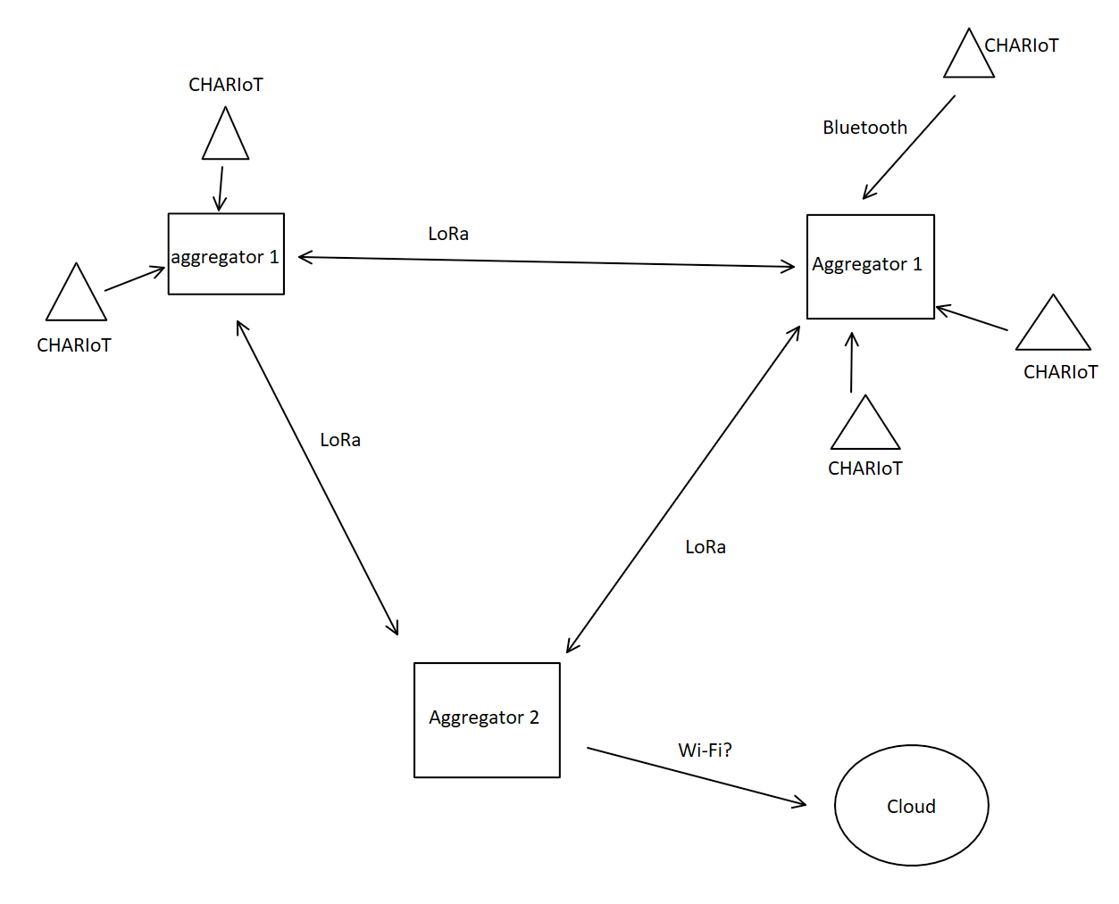
Comms

